Slide 1

EVALUATION METRICS

Slide 2
PERFORMANCE EVALUATION METRICS - ACCURACY
#correct Prediction
Total # of Predictions
So far we have just been evaluating the performance of our algorithms based on accuracy

Slide 3
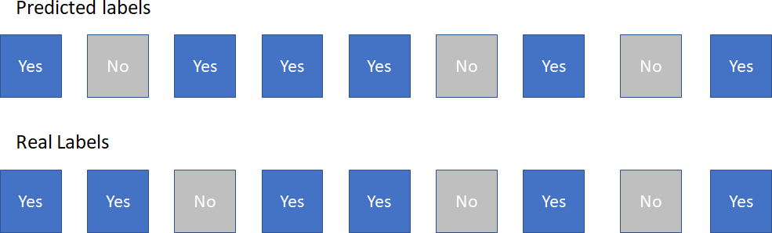
PERFORMANCE EVALUATION METRICS - ACCURACY
#correct Prediction
Total # of Predictions
So far we have just been evaluating the performance of our algorithms based on accuracy

Slide 4
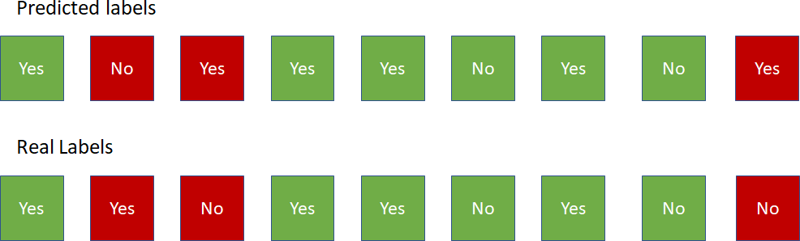
PERFORMANCE EVALUATION METRICS - ACCURACY
#correct Prediction
Total # of Predictions
So far we have just been evaluating the performance of our algorithms based on accuracy

Slide 5

PERFORMANCE EVALUATION METRICS - ACCURACY
#correct Prediction
Total # of Predictions
So far we have just been evaluating the performance of our algorithms based on accuracy

Slide 6
PERFORMANCE EVALUATION METRICS - ACCURACY
#correct Prediction
Total # of Predictions
How can accuracy be deceptive?
Imbalanced Datasets
Importance of incorrect prediction of a certain class

Slide 7
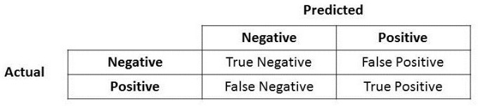

PERFORMANCE EVALUATION METRICS – CONFUSION MATRIX

Slide 8


PERFORMANCE EVALUATION METRICS – CONFUSION MATRIX
Type I error
Type II error

Slide 9
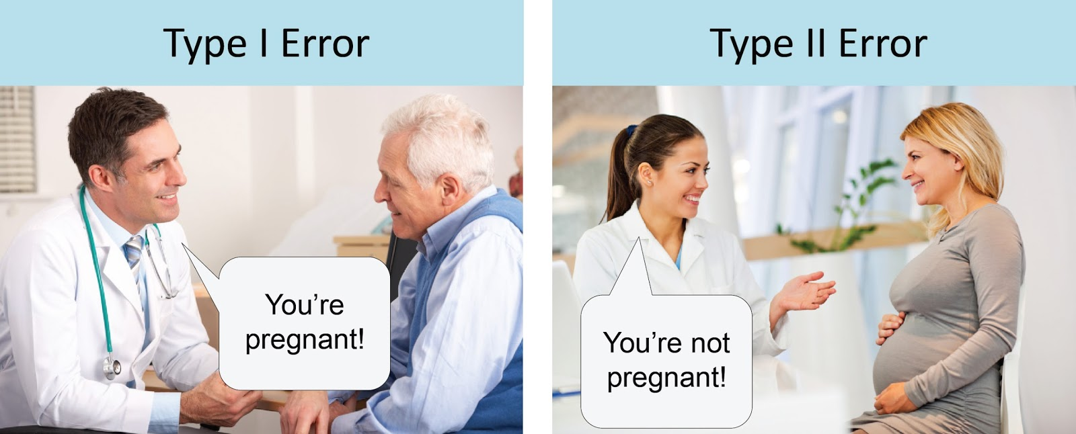
PERFORMANCE EVALUATION METRICS – CONFUSION MATRIX
Type I error
Type II error

Slide 10
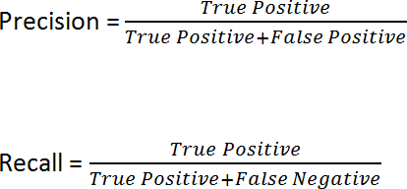
PERFORMANCE EVALUATION METRICS - PRECISION & RECALL

Slide 11
PERFORMANCE EVALUATION METRICS - PRECISION & RECALL
Let's describe these two concepts through words & intuition
Precision of Class A:
From all the datapoints I predicted to be "A", how many were A?
Example: From a universe of 1000 people, we predicted 10 had coronavirus. In fact only 8 out of these 10 were actually infected.
Precision = 8/10 == 80%

Slide 12
PERFORMANCE EVALUATION METRICS - PRECISION & RECALL
Let's describe these two concepts through words & intuition
Recall of Class A:
From all the datapoints that truly were "A", how many did we predict?
Example: From a universe of 1000 people, 100 are actually infected with corona virus (we do not know this, of course) we correctly predicted that 50 people had the virus
Recall = 50/100 == 50%

Slide 13
PERFORMANCE EVALUATION METRICS - PRECISION & RECALL
Which one should we prioritize?
DEPENDS ON THE PROBLEM
However, we have to learn how to decide which one we want to prioritize: In predicting email spam what's more dangerous:
Brute Force Precision: predict NOTHING IS SPAM unless it clearly states that the prince of Nigeria needs your help and will repay you handsomely if you transfer 100$ to a certain IBAN
Brute Force 100% Recall: predict that every your email you receive is spam. Regardless how many are actually spam, you will catch 100% of the spam

Slide 14
PERFORMANCE EVALUATION METRICS - PRECISION & RECALL
Which one should we prioritize?
DEPENDS ON THE PROBLEM
However, we have to learn how to decide which one we want to prioritize: Predict if a patient has cancer
Brute Force Precision: only claim the patient has cancer if every single test comes up true multiple times in a row
Brute Force Recall: assume that a patient has cancer "to play it safe" before more tests come in

Slide 15

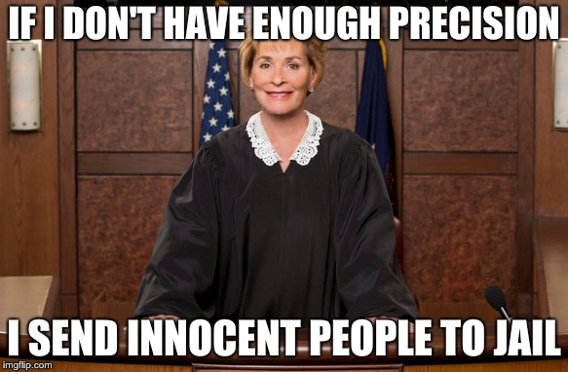
PERFORMANCE EVALUATION METRICS - PRECISION & RECALL
Which one should we prioritize?

Slide 16
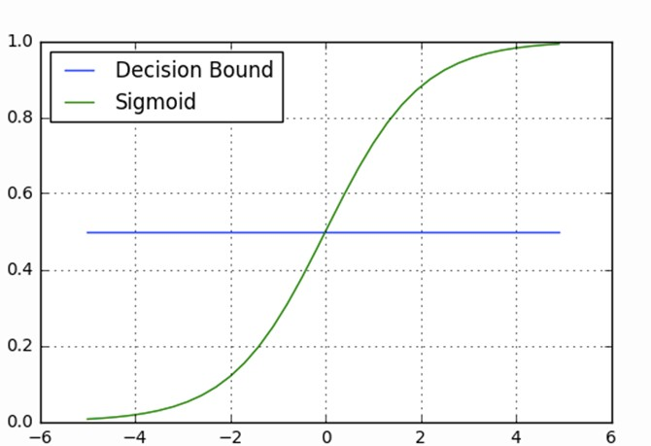
PERFORMANCE EVALUATION METRICS - LOGISTIC REGRESSION
Class 1
How do you relate the decision boundary to precision/recall in the logistic regression algorithm?
Sigmoid(z)
Class 0
z

Slide 17

PERFORMANCE EVALUATION METRICS - F1 SCORE
A Trade-off between both such that the algorithm doesn't improve too much one of them at the expense of the other

Slide 18
ANY
QUESTIONS ?

Slide 19
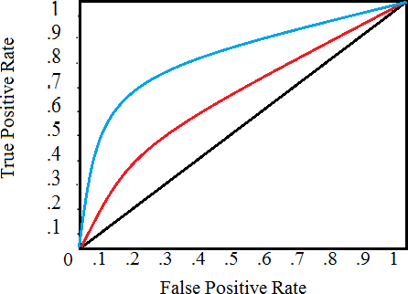
PERFORMANCE EVALUATION METRICS - ROC CURVE
It is a plot of the false positive rate (x-axis) versus the true positive rate (y-axis) for a number of different candidate threshold values between 0.0 and 1.0. Put another way, it plots the false alarm rate versus the hit rate.
Data Squad | Supervised Learning

